Slide 1
Final Engagement
Attack, Defense & Analysis of a Vulnerable Network

Slide 2
Table of Contents
This document contains the following resources:
Network Topology & Critical Vulnerabilities
Exploits Used
Methods Used to Avoiding Detect

Slide 3

Network Topology
& Critical Vulnerabilities
‹#›

Slide 4
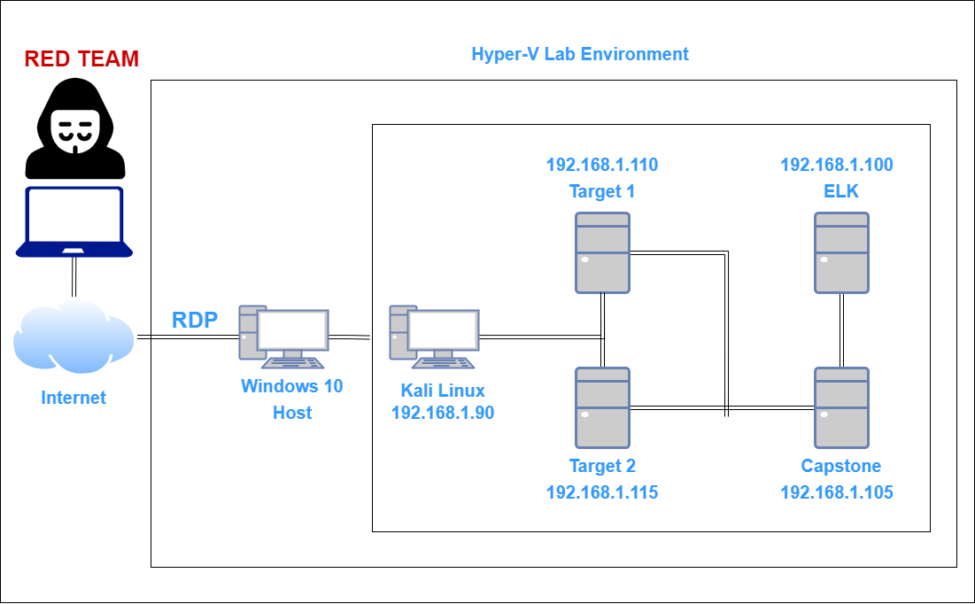
Network Topology
Network
Address Range: 192.168.1.1/24
Gateway: 192.168.1.1
Machines
IPv4: 192.168.1.90
OS: Kali Linux
Hostname: kali
IPv4: 192.168.1.110
OS: Linux
Hostname: Target1
IPv4: 192.168.1.115
OS: Linux
Hostname: Target2
IPv4: 192.168.1.100
OS: Linux
Hostname: ELK

Slide 5
Critical Vulnerabilities: Target 1
Our assessment uncovered the following critical vulnerabilities in Target 1.
Vulnerability | Description | Impact
Wordpress Core not updated | Security Patches needed | High
Cleartext Passwords | Sensitive Files Exposed | High
Weak Hashed Passwords | Password Complexity | High

Slide 6
Exploits Used
‹#›

Slide 7
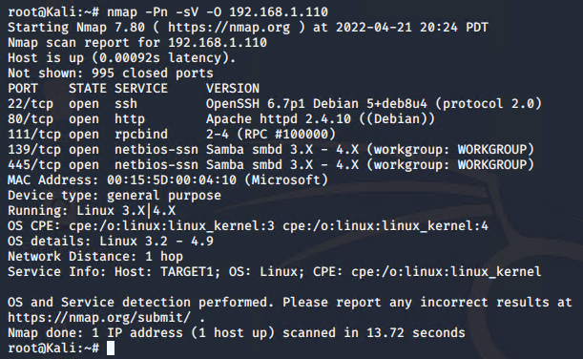
Exploitation: Wordpress Enumeration
Steps taken:
nmap scan to view open ports: nmap -sV -Pn 192.168.1.110

Slide 8
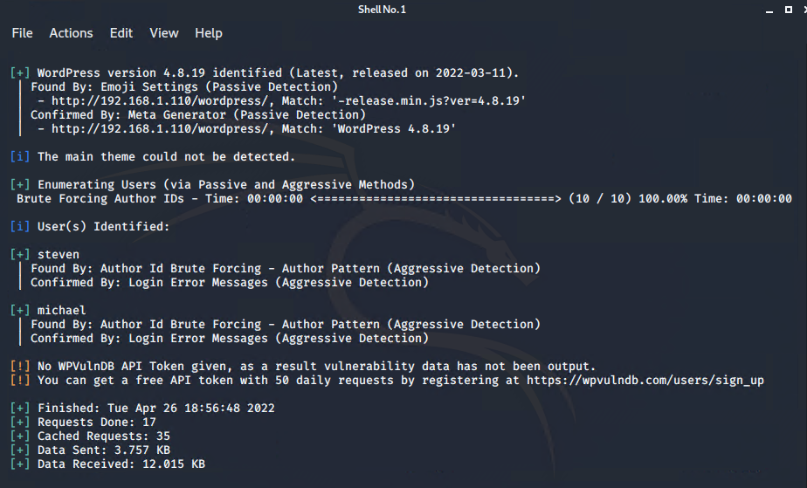
Exploitation: Wordpress Enumeration
wpscan –url http://192.168.1.110/wordpress –enumerate u

Slide 9
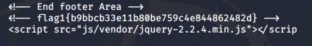
Exploitation: Wordpress Enumeration
Browsing the directory, we can locate the first flag in /var/www/html/service.html:

Slide 10
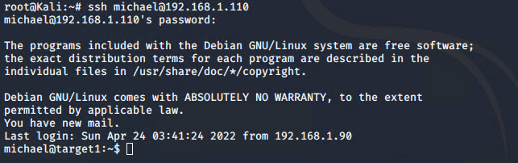
Exploitation: Wordpress Enumeration
The description of the assignment stated the user “michael” had an easy to guess password: “michael”
Using these credentials, we were able to access the Target Machine using SSH.

Slide 11
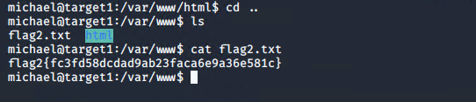
Exploitation: Wordpress Enumeration
Once again browsing the directories for interesting and important files, we found flag 2:

Slide 12
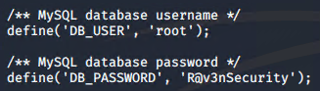
Exploitation: No encryption of sensitive files
Continuing our directory browsing, we found an important and sensitive file, wp-config.php file. This file showed in cleartext the credentials for SQL.

Slide 13
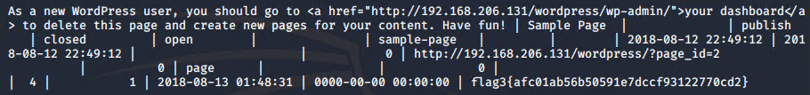
Exploitation: Exposed Sensitive Files
We can now log into SQL using these credentials. Once logged in, we can search through the databases using the “show databases;” and then “show tables;” commands. The database interesting to us is wordpress and the table wp_posts. Viewing this, we now have our third flag:

Slide 14
Exploitation: Weak Hashed Passwords
From there we can also see another table of interest: wp_users. Opening that table now gives us usernames and password hashes. We already know michael’s password, so we can try and crack steven’s password hash. We need to save the hashes to a text file, using the following format: user1:$PassHash. Once that is done we can use john the ripper to crack the hash

Slide 15
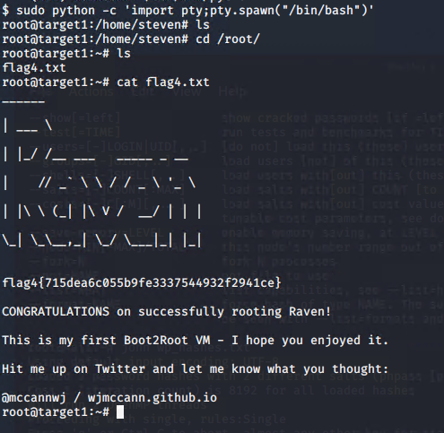
Exploitation: Weak Hashed Passwords
Once we have the password, we can now log into Target1 using steven’s credentials. When we log in, we see that steven has access to run python scripts. We can try using an python exploit to gain root access:
sudo python -c ‘import pty;pty.spawn(“/bin/bash”)’
We’re in! We now have root access and also flag 4

